Slide 1
Springworks Farm Study Resealable Lidding Film
Windham Packaging, LLC
Gabriela McCarthy

Slide 2
Summary and Conclusions
The objective of the study was to test Windham Packaging resealable lidding films on Springworks products to determine if increased perforation patterns would help decrease condensation within the package.
Currently, all samples are being packaged at Springworks in a non-temperature-controlled area. If leafy greens are packaged warm and then cooled, they produce a significant amount of water vapor which then condenses into water when the temperature cools. The water collects on the package, reducing product visibility and causing issues with product wetness and decay.
By increasing the number of perforations, our goal was to allow some of the water vapor to escape the package and reduce condensation. This caused all samples to have ambient headspace levels (~20% O₂ / 0.3% CO₂) throughout the study and therefore, the benefits of increased shelf life through modified atmosphere were lost.

Slide 3
Summary and Conclusions
At the end of the study (20 days), Bibb lettuce had acceptable quality and had not yet reached the end of its shelf life. Bibb lettuce had minimal to no condensation throughout the study. It can handle reduced perforation patterns and would likely benefit from a modified atmosphere. We suggest reducing the number of microperforations in the Bibb package.
Romaine samples had not reached the end of shelf life by day 20. Samples stored upside down had better visibility on the lidding film (less condensation on the lid), but condensation from the hydrophobic PET tray dropped down onto the product making the leaves wet. However, quality did not seem to be dramatically affected by this so packing the trays like you are currently doing (one face down and one face up), may not be as detrimental as we first thought. Condensation was moderate to severe in all samples and we recommend keeping a high perforation pattern for the romaine.
Salad mix had a shelf life of 18 days. End of shelf life was due to oxidation (pinking/browning) of cut ends. This can be controlled with decreased O₂ levels within the package, or use of an ascorbic acid spray. However, condensation was still present and leaves were wet so we do not recommend reducing the number of perforations unless the leaves are cooled before packing and the packing operation is done at 40 F.
Green leaf lettuce had a shelf life of 13 days. End of shelf life was due to yellowing, decay, and off odor. We recommend keeping the perforation pattern high because condensation was significant throughout the study. The pinking/browning of the cut ends can be reduced with an ascorbic acid spray which would help to maintain a better visual appearance throughout storage.

Slide 4
Results and Discussion:
Internal Temperature and Headspace Analyses
Visual Quality Throughout Shelf Life
Photos
Visual Comparisons and Presence of Defects among Samples
Shelf Life Studies

Slide 5
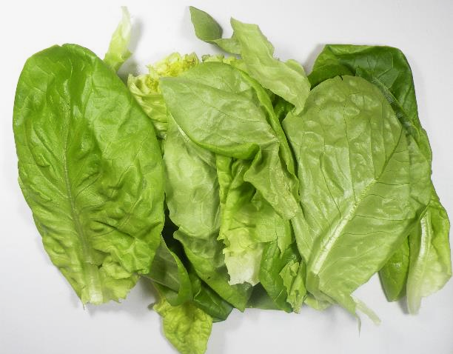
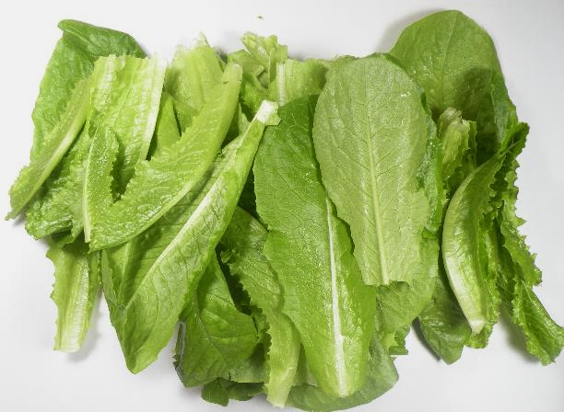
Day 4
Bibb (right side up)
Minimal condensation on the lidding film.
Appearance and smell were fresh.
Taste was fresh and slightly bitter
Outer leaves looked fresh and some inner leaves had browning on the edges
Romaine (right side up)
Moderate condensation on lidding film
Leaves slightly wet
Slight odor when opening lid, but it dissipated
Appearance and taste were fresh
Day 4 Bibb
Day 4 Romaine

Slide 6
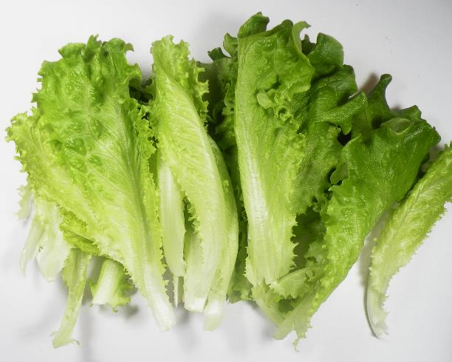
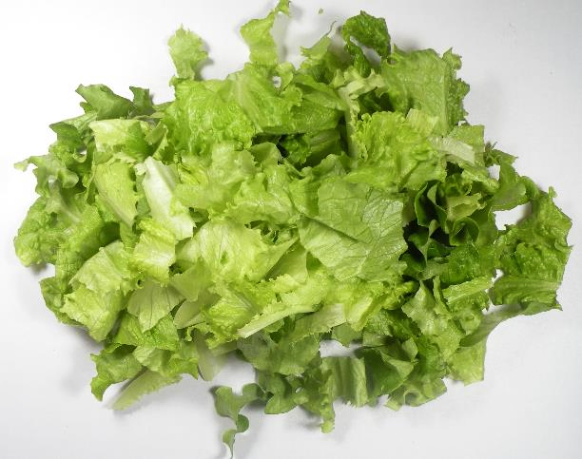
Day 4
Green Leaf (right side up)
Moderate condensation on the lidding film
Slight odor when opening lid, but it dissipated
Fresh but bitter taste
Fresh appearance
Salad Mix (right side up)
Fresh appearance, odor, and taste.
Taste was mild and slightly sweet
Day 4 Green Leaf
Day 4 Salad Mix

Slide 7
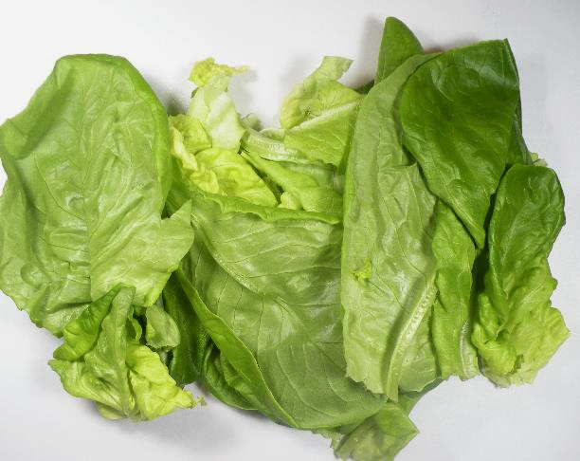
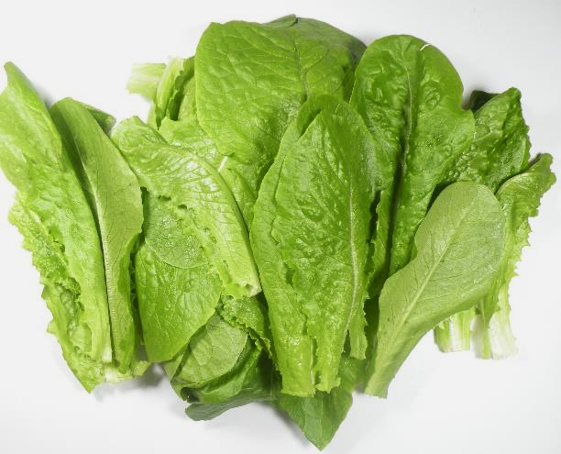
Day 6
Bibb (right side up)
No condensation in the package
Slight odor when opening lid, but it dissipated
Appearance and taste were fresh
Romaine (right side up)
Moderate condensation on lidding film
Top leaves slightly wet
Appearance and smell were fresh
Taste was fresh but slightly bitter
Day 6 Bibb
Day 6 Romaine

Slide 8
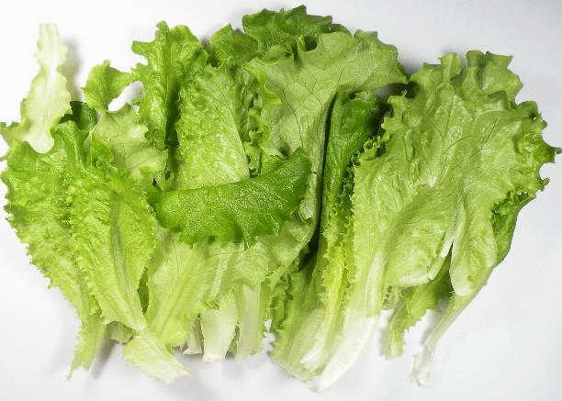
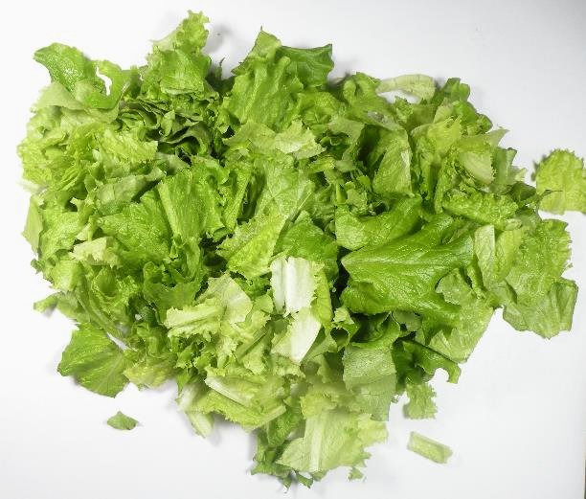
Day 6
Green Leaf (right side up)
Moderate condensation on the lidding film
Slight odor when opening lid, but it dissipated
Taste was ok, but bitter
Browning on cut ends
Salad Mix (right side up)
Appearance was good but not as fresh as the other samples
Slight odor when opening lid, but it dissipated
Taste was good – sweet with slightly bitter after taste
Slight signs of browning on cut ends
Day 6 Green Leaf
Day 6 Salad Mix

Slide 9
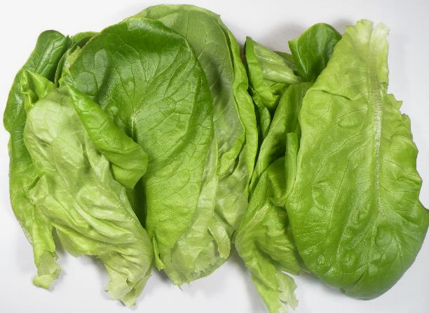
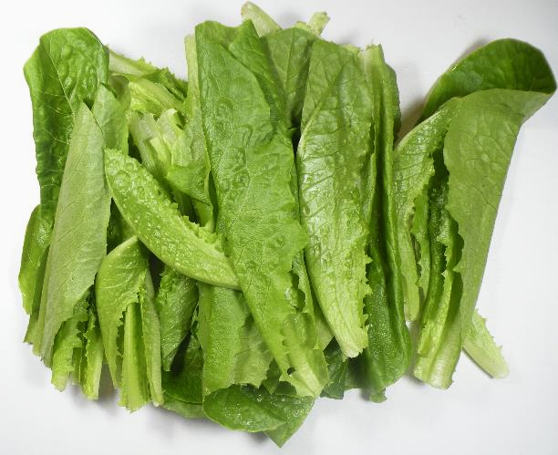
Day 8
Bibb (right side up)
No condensation in the package
Slight odor when opening lid, but it dissipated
Appearance was fresh
Taste was good but bitter
Romaine (upside down)
Moderate condensation on tray but no condensation on the lidding film
Leaves touching lidding film were wet
Indicates droplets were falling from the tray to the bottom of the package
Appearance and smell were fresh
Taste was fresh
Day 8 Bibb
Day 8 Romaine

Slide 10
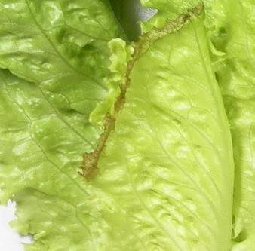
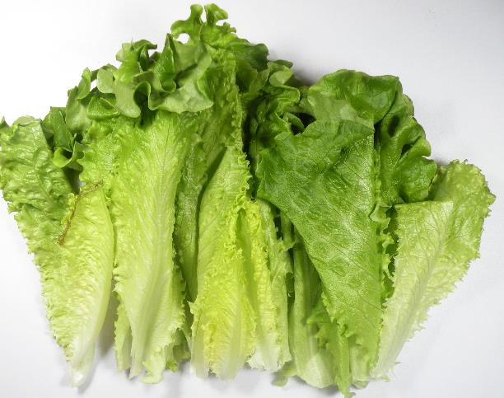
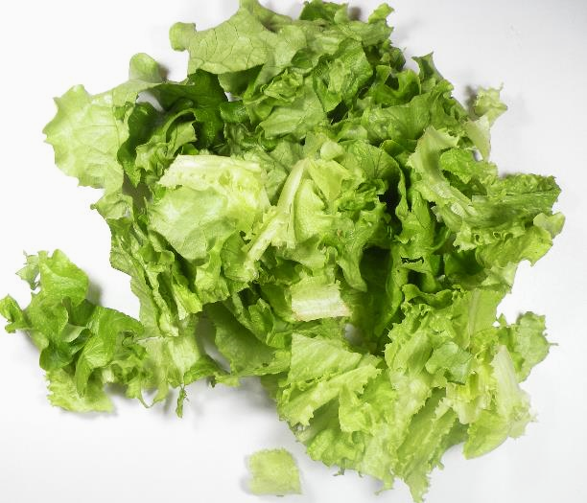
Day 8
Green Leaf (upside down)
Moderate condensation on the tray
Odor when opening lid, but it dissipated
Appearance was mostly fresh, 1 leaf had browning/decay on the edges
Taste was ok, but bitter
Salad Mix (right side up)
Some droplets on the lid
Leaves were wet
Leaves were starting to turn brown
Odor when opening lid, but it dissipated
Taste was good – sweet with slightly bitter after taste
Day 8 Green Leaf
Day 8 Salad Mix

Slide 11
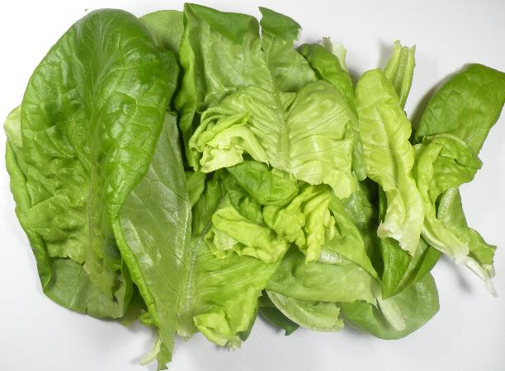
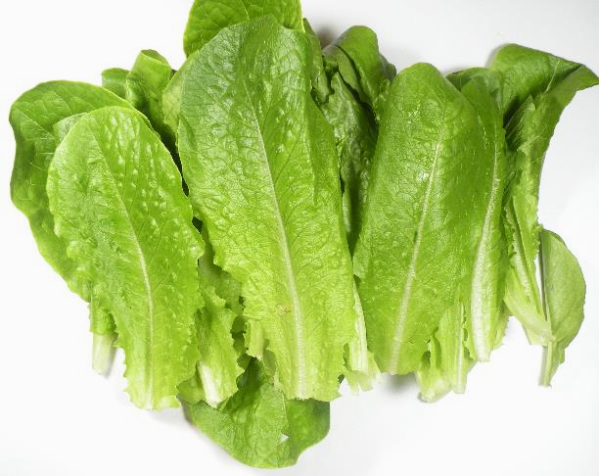
Day 12
Bibb (right side up)
Slight condensation on tray sides
Appearance was fresh
Taste was good but bitter
4.4% leaves showed signs of decay
Romaine (right side up)
Moderate/severe condensation on lidding film
Top leaves were wet
Appearance and smell were fresh
Taste was fresh but slightly bitter
Browning on cut ends
Day 12 Bibb
Day 12 Romaine

Slide 12
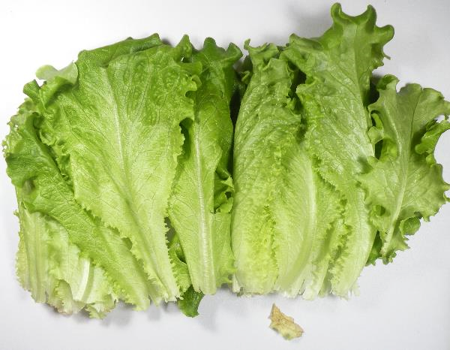
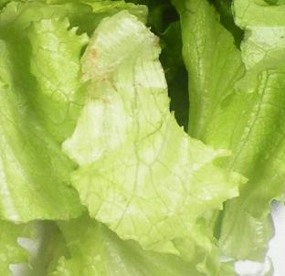
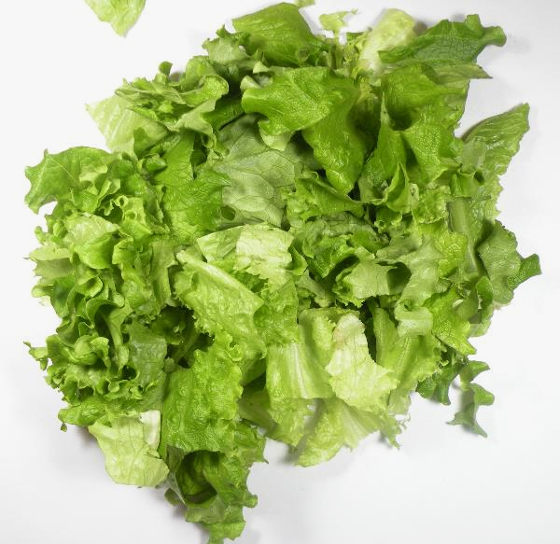
Day 12
Green Leaf (upside down)
Moderate condensation on tray bottom
Odor when opening lid, but it dissipated
Taste was good, but bitter
Browning on cut ends
0.8% leaves showed signs of decay
Salad Mix (right side up)
Moderate condensation on lidding film
Odor when opening lid, but it dissipated
Taste was good
12.6% leaves had browning/decay
Day 12 Green Leaf
Day 12 Salad Mix

Slide 13
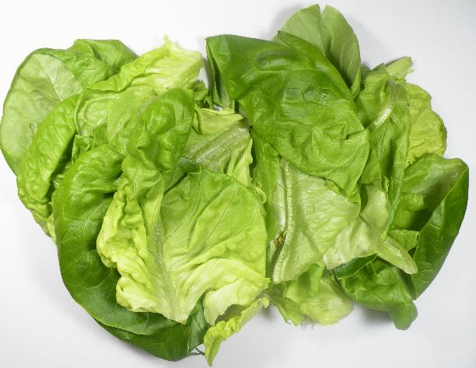
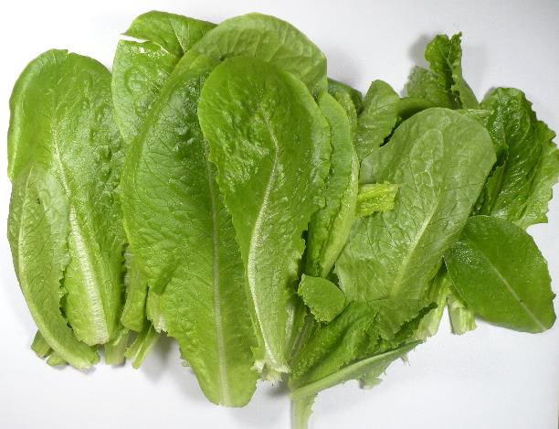
Day 14
Bibb (right side up)
No condensation on package
Appearance was fresh
Taste was bitter
Leaves were slightly wet, texture was softer
0.4% leaves showed signs of decay
Romaine (upside down)
Severe condensation all sides of the tray
Leaves touching lidding film were wet
Slight odor when opening lid, but it dissipated
Appearance was fresh
Taste was bitter
Browning on cut ends
1.6% leaves had decay
Day 14 Bibb
Day 14 Romaine

Slide 14
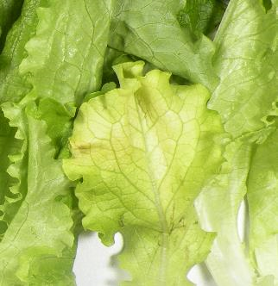
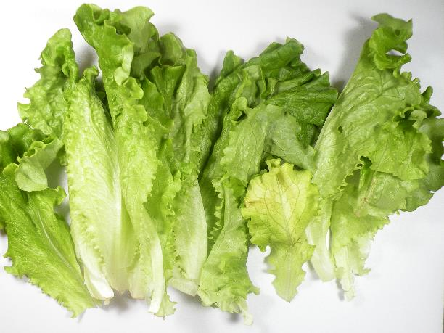
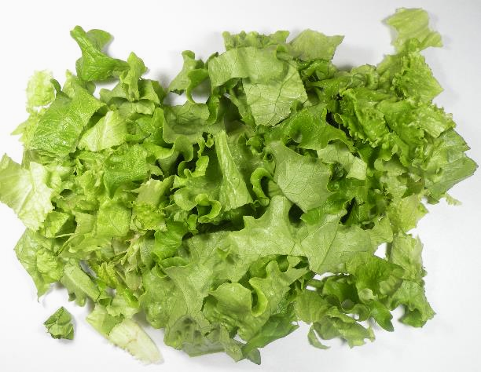
Day 14
Green Leaf (right side up)
Slight to moderate condensation on tray bottom
Off odor
Very bitter taste
Browning on cut ends
8.8% leaves had decay
5.3% leaves were yellowing
End of shelf life
Salad Mix (right side up)
Moderate condensation on lidding film
Odor when opening lid, but it dissipated
Leaves were wet
Taste was good, mild
10.1% leaves had browning/decay
Day 14 Green Leaf
Day 14 Salad Mix

Slide 15
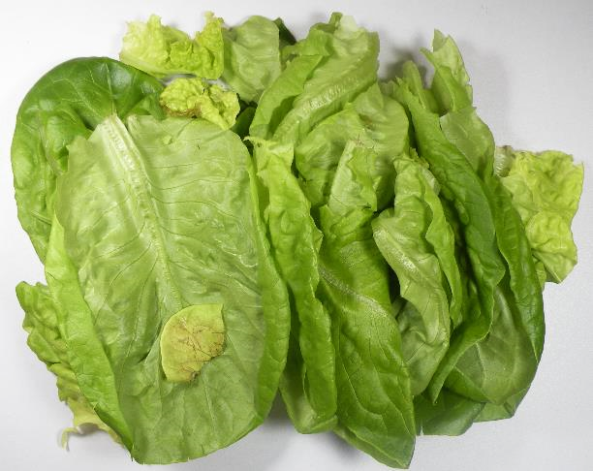
Day 20
Bibb
No condensation on package
Appearance was fresh
Taste was good but bitter
1.3% leaves had decay (mostly smaller leaves)
Romaine
Tasted good, but bitter
Leaves were wet
Cut ends were brown, otherwise looked fresh
Day 20 Bibb
Day 14 Romaine

Slide 16
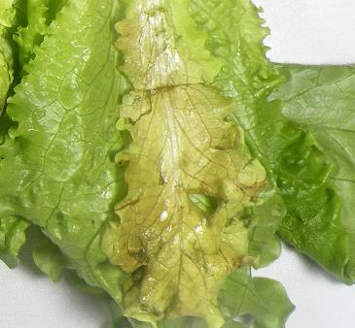
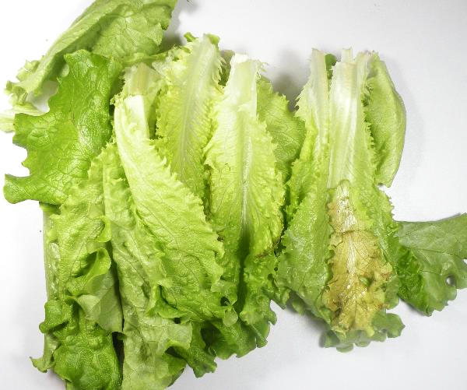
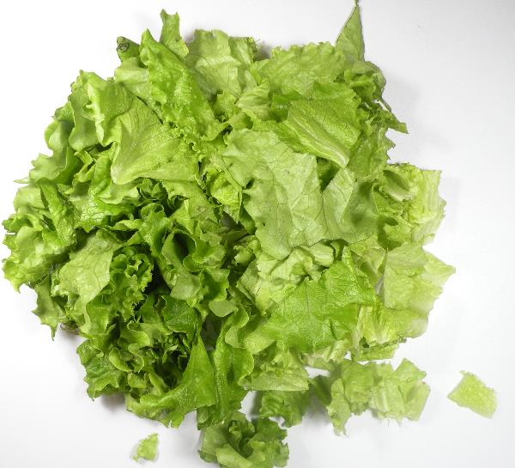
Day 20
Green Leaf
Appearance and odor were past the point of acceptability
Taste was ok, but bitter
8.2% leaves had decay
Salad Mix
Odor upon opening
Leaves were wet
Taste was good, mild
Cut ends were pink/brown
3.9% leaves had decay
Day 20 Green Leaf
Day 20 Salad Mix

Slide 17
Materials and Methods
Windham Packaging provided samples of peel/reseal lidding film with high perforation pattern to offset high moisture content within the packages.
Romaine, salad mix, green leaf, and bibb lettuce samples were packed at Springworks facility.
The harvested product was transported to Windham Packaging in cartons kept at room temperature.
In cartons packaged with green leaf and romaine, the bottom layer of trays were stored upside down.
Packages were left in their cartons and stored at 50°F for the remainder of the study.

Slide 18
Procedures: Quality Testing
Quality observations such as decay, yellowing, mold/mildew, mechanical damage, stem color, browning, taste and off-odor were observed. Samples were tested on days 4, 6, 8, 12, 14, 16, and 20.
Headspace readings inside packages were checked using a gas analyzer
Shelf life studies were done on each sample during each test day.

